Slide 1
Cracking AirBench
AlphaGrad
Week 9 Update

Slide 2
What we are optimizing
LLMs are good at generating solutions, but bad at verifying them
Many approaches have tried to answer this (ex. LLM as a Judge)
One solution: evaluate LLMs against a strictly verifiable problem
Many such examples:
Kernel speed
Matrix multiplication algorithm speed
Erdos problems

Slide 3
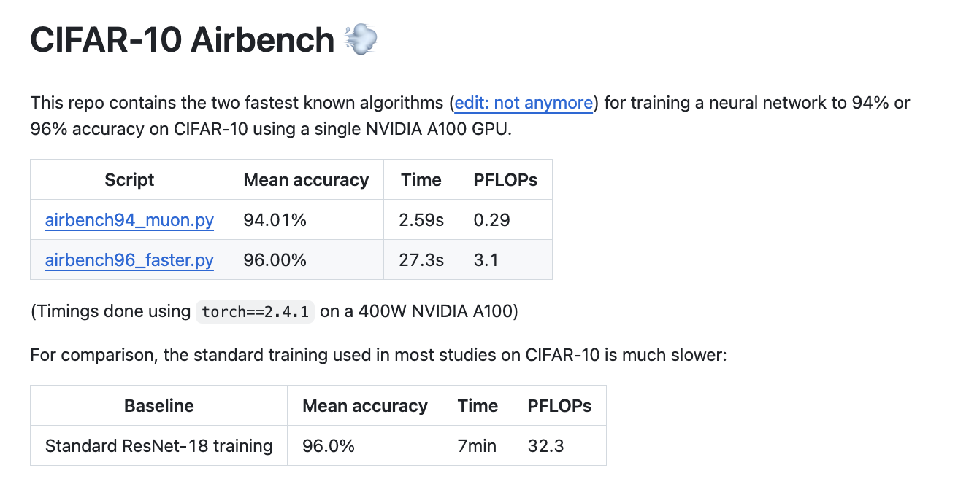
CIFAR-10 AirBench

Slide 4
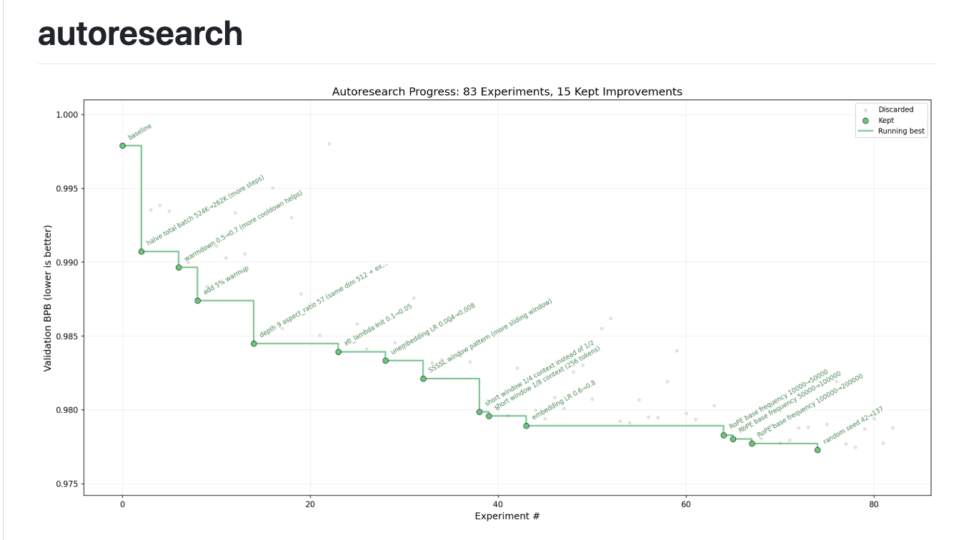
Idea: An automated AI researcher in a loop
Karpathy’s autoresearch repo applies this to optimizing training for nanochat
Github link

Slide 5
How it Works:
Same core loop as AlphaEvolve + autoresearch: propose → evaluate (strict verifier) → keep best → iterate
Continuously append success/failure data to memory.md so agent can grow from past explorations
Use free Gemini model (gemini-3.1-flash-lite-preview) + A100-40GB GPU on Modal for serverless training in seconds
Start from the best incumbent script in AirBench repo, see if we can beat the record

Slide 6
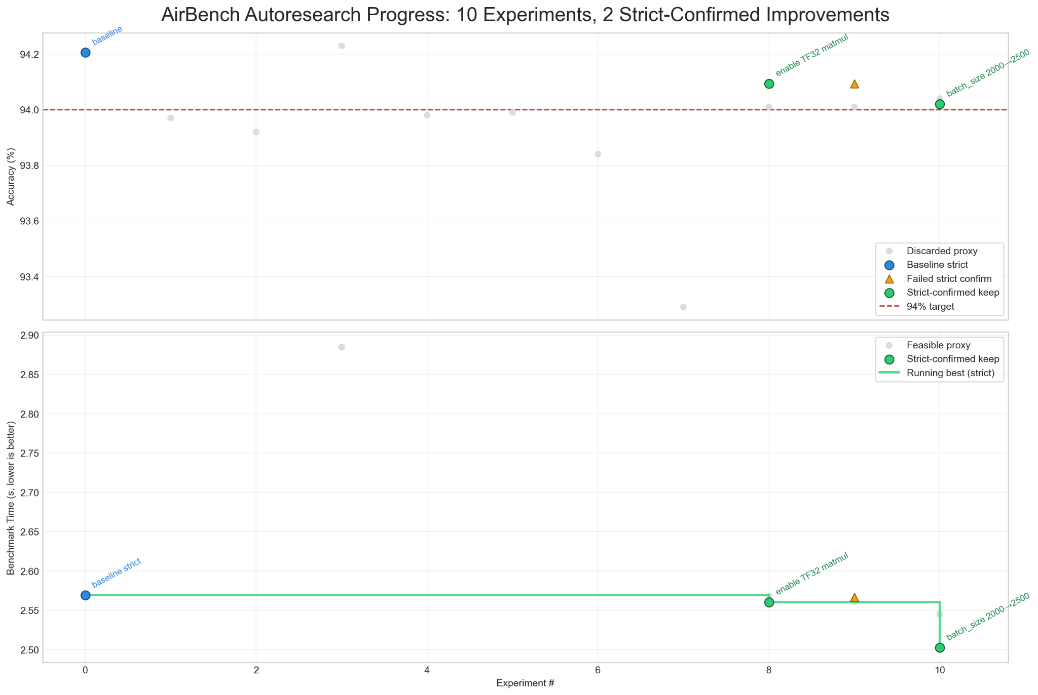
Initial results

Slide 7
Initial results
Lowered SOTA training time to ~2.50 from ~2.59 (~2% improvement)
But have not rigorously evaluated the solution under the same conditions (one warmup round then take average of 200x runs)
Code edits:
enable torch.set_float32_matmul_precision('high')
increase batch size 2000 -> 2500

Slide 8
Steps forward:
Use multi-agent optimization loop
Outer coordinator suggests high level strategy.md
Inner agents each run suggestions (in parallel) then coordinator picks best one
Need to better draw fine line between making not enough substantive edits (only tweaking one hyperparameter multiple times) and making too many edits (code does not compile)
Use stronger models (GPT-5.4 level)

